Slide 1
Innovation Practices
First Review

Slide 2
Team members
Indra Shekar(19z219)
Sanjai(19z241)
Soumen Saha(19z245)
Viveknandan(19z261)
Manoj(19z263)
Mentor
Ms. A. Bharathi, Asst. Professor
Department of computer science and engineering

Slide 3
Presentation flow
1
4
Abstract
System analysis and design
2
5
Literature survey
Reference
3
6
Hardware and software requirements
Workflow

Slide 4
Abstract
To create character and word based neural network models using the available datasets like IAM dataset. Evaluate the models with their accuracies and picking the best one.
Pre-process the input invoice image using OpenCV and converting it into formatted digital document using the model we created.
Then extracting the whole text from the digital document using existing models like pytesseract, vision, etc.
Problem Statement
Healthcare Document Data Capture

Slide 5
Literature Survey
Some of the previously used models for text recognition
Tesseract OCR:
Tesseract is a OCR engine developed for printed text extraction. So, for handwritten text recognition, it is more challenging because of the high variation in the handwriting styles from person to person. Hence Tesseract can not achieve satisfying results unless the texts are hand-printed.
Hence the next improvement for the model should be in capturing the features and varying patterns in different handwriting styles.

Slide 6
Literature Survey
Some of the previously used models for text recognition
2. Google’s Cloud Vision:
Google Cloud Vision is an API from google for extracting handwritten text. Cloud Vision offers pre-trained machine learning models which are very powerful and we do not need any pre-training. Since it is specially made for handwritten text recognition, it will do a much better job in extracting text from images than Tesseract.
3. Recurrent Convolutional Neural Network:
CRNN is a combination of CNN, RNN, and CTC (Connectionist Temporal Classification), loss for image-based sequence recognition tasks, such as scene text recognition tasks and OCR. This neural network architecture integrates feature extraction, sequence modelling, and transcription into a unified framework.

Slide 7
Literature Survey
Some of the previously used models for text recognition
4. VGG-19: VGG-19 is a 19-layer deep Convolutional Neural Network (CNN). It is pre-trained model trained on more than a million images from the ImageNet database. 5. RESNET-18: RESNET is a 18-layer deep Convolutional Neural Network used for object detection. 6. RESNET-34: RESNET- 34 is a 34 layer Convolutional Neural Network that can be utilised as a state-of-art image classification model.

Slide 8
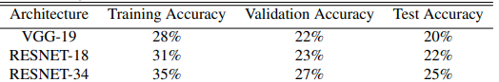
Literature Survey

Slide 9
Hardware and Software Requirements
Hardware Requirements
Windows or Linux OS with 16GB ram
01
02
Nvidia high end GPU
03
Minimum i5 intel Processor
04
Uninterrupted internet for Colab

Slide 10
Hardware and Software Requirements
Python IDE or Jupyter notebook with the following packages
Software Requirements
01
Pandas
Pytesseract
02
03
Open CV
TensorFlow
04
05
Matplotlib
NLTK
06

Slide 11
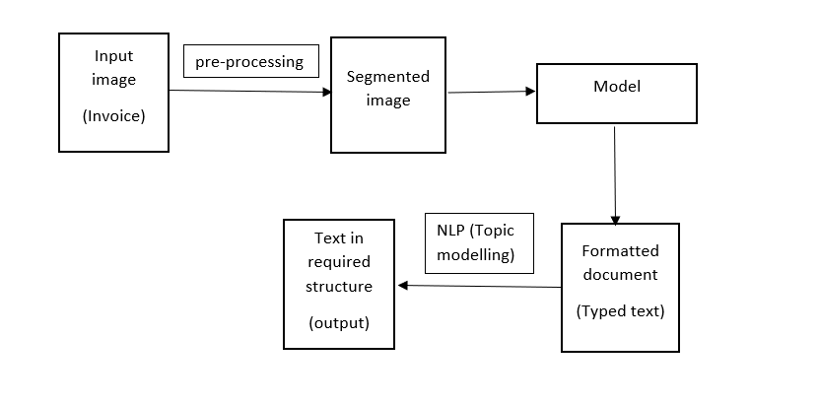
System Analysis and Design

Slide 12
References
https://blog.hexstream.com/process-handwritten-text-using-python-and-cloud-vision
https://medium.com/@derrickfwang/printed-and-handwritten-text-extraction-from-images-using-tesseract-and-google-cloud-vision-api-ac059b62a535
https://github.com/DerrickFeiWang/HandwritingRecognition_GoogleCloudVision
https://pyimagesearch.com/2020/08/24/ocr-handwriting-recognition-with-opencv-keras-and-tensorflow/
https://nanonets.com/blog/deep-learning-ocr/
https://towardsdatascience.com/build-a-handwritten-text-recognition-system-using-tensorflow-2326a3487cd5

Slide 13
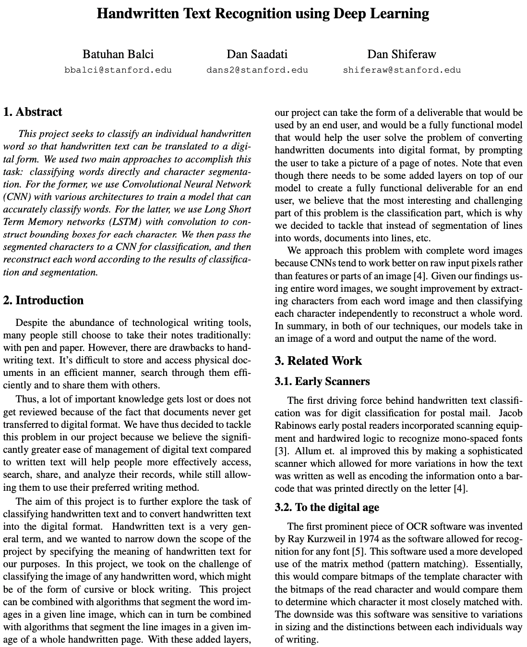
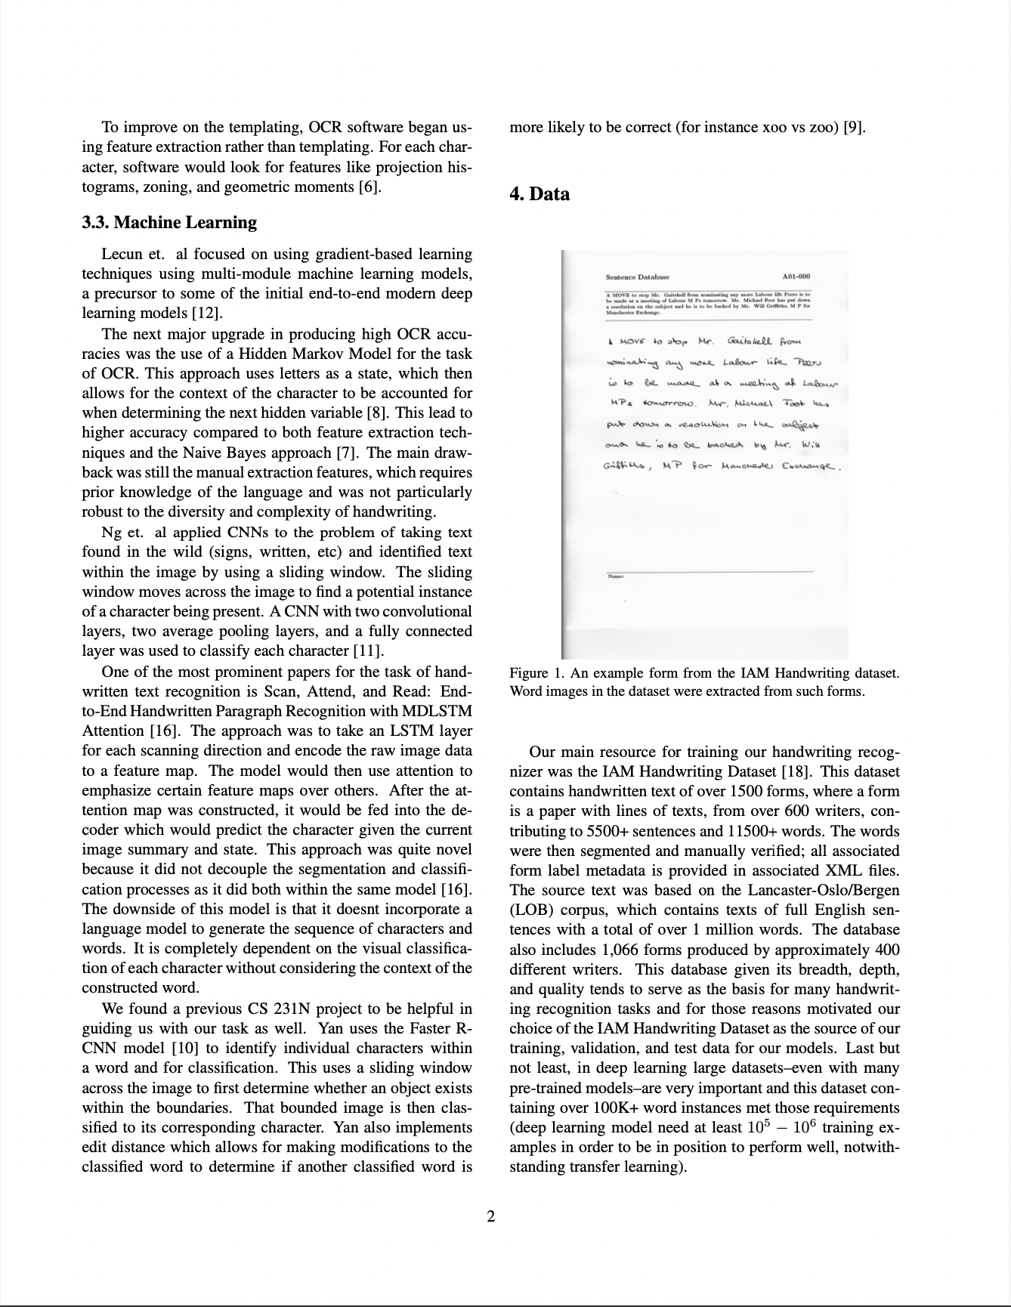

Slide 14
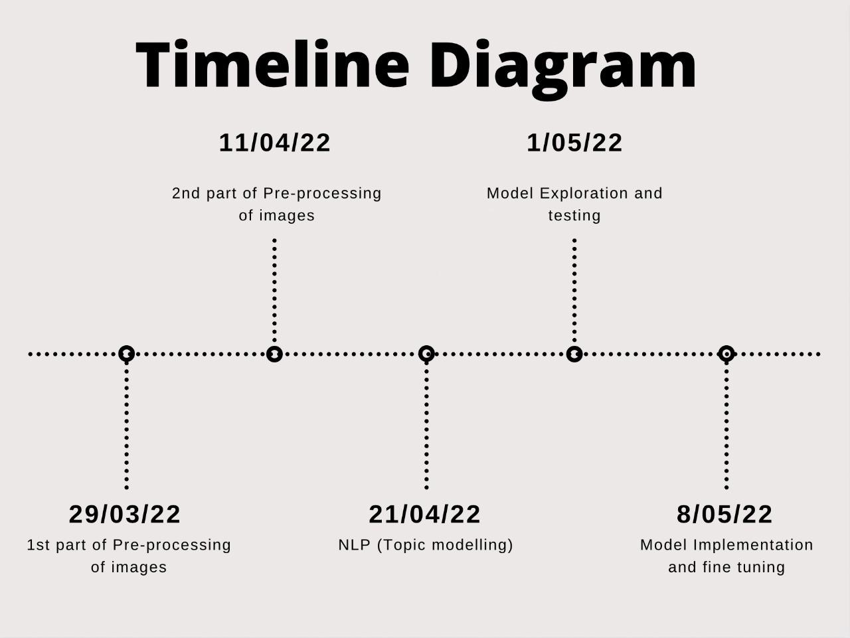
Workflow
ML for business

Slide 15
Status of work
1. Pre-processing
Used digital image for pre-processing
Techniques used:
Colored image to grayscale
Noise Removal (blurring)
Thresholding
Erosion
Morph
Canny edge detection
Skew Correction
Template matching
Boxing
ML for business

Slide 16
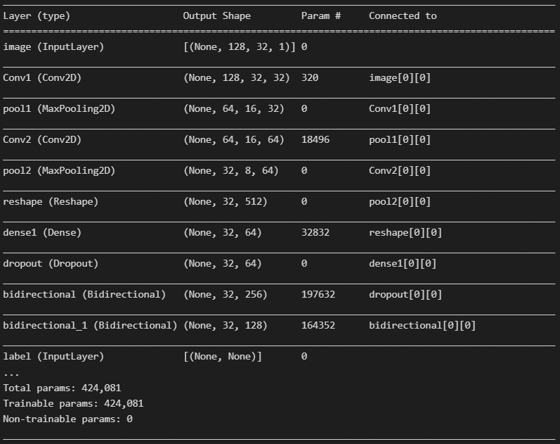
2. Model Training
We created a simple CRNN model using IAM dataset.
Model architecture:
Input Layer - 1
Convolutional layers - 2
Pooling Layers - 2
Reshape layer - 1
Dense Layers - 2
Dropout Layer - 1
Bidirectional layers - 2
CTC Layer - 1

Slide 17
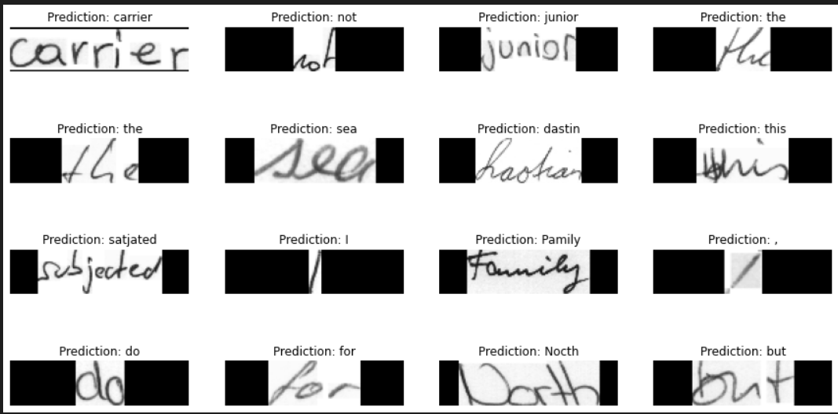
3. Model Testing

Slide 18
Future Developments
Pre-Processing
To complete line and word segmentation for the bills.
NLP
Topic modeling (topic information retrieval from text)
Model Testing
Testing the model with various sample bills
Post processing
Transforming the predicted text into a particular format

Slide 19
Thank You

